Slide 1
HOSPITAL MANAGEMENT SYSTEM
DATABASE MANAGEMENT SYSTEM
(CS19443)
Priyadarshini M -220701206
Radhika Rakesh -220701208

Slide 2
ABSTRACT
Project Focus:
This project aims to develop a user-friendly, secure, and efficient hospital management system using Python for front end development and MySQL as the relational database management system.
Benefits:
Improved Efficiency: Streamline administrative tasks (appointments, billing, record management) to save time and resources.
Enhanced Data Management: Organize and centralize hospital data for easier access, analysis, and decision-making.
Increased Accuracy: Reduce errors by automating data entry and validation.
Improved Patient Care: Facilitate better communication between healthcare professionals and patients.
Scalability: The system can grow and adapt as the hospital's needs evolve.

Slide 3
Services available
01.
Patient Registration
02.
03.
List of doctors
Appointment scheduling and management.
04.
PROJECT SCOPE
Modifying existing data
05.

Slide 4
SOFTWARE REQUIREMENTS
Front-End: The system will utilize a user-friendly interface developed with a popular programming language like python
Database Connectivity
Libraries: Utilize libraries like MySQL dB for MySQL
Data Transfer:
Sending Data: When users interact with the interface (adding information, searching), the front-end will use the chosen library to send data manipulation requests (INSERT, UPDATE, DELETE) or queries (SELECT) to the back-end DBMS.
Receiving Data: The back-end will process the requests and send back the requested information or confirmation of successful operations. The front-end will then display the retrieved data or confirmation messages to the user.
Back-End: Data will be stored and managed in a secure database such as MySQL. It offers good performance, scalability, and a large user community for support.
Implementation with MySQL:
MySQL Server: A MySQL server to act as the back-end database storage.
Database Creation: Use tools like MySQL Workbench or command-line tools to create the database based on your designed schema.
Table Creation: Define tables within the database, specifying data types for each attribute .
Data Manipulation: Develop functionalities to insert, update, and delete data within the tables using Structured Query Language (SQL).
User Interface Design:
Emphasis on User Experience: Design a visually appealing and user-friendly interface
Data Input Forms: Create forms with appropriate input fields
Data Interaction Features
User Registration
Login
Data Entry
Data Editing
Data Deletion
Search and Filtering

Slide 5
ENTITIES
APPOINTMENT
Attributes: AppointmentID PatientID,DoctorID Date Time
ROOM
Attributes: RoomNumber DepartmentID OccupancyStatus
PATIENT
Attributes: PatientID, Name, Age Gender, Phone, Address,Bloodgroup
DOCTOR
Attributes: DoctorID,Name Gender,Specialization DepartmentID,RoomNumber
DEPARTMENT
Attributes: DepartmentID,Name HeadDoctorID
SERVICE
Attributes: ServiceID,Name Description,DepartmentID

Slide 6
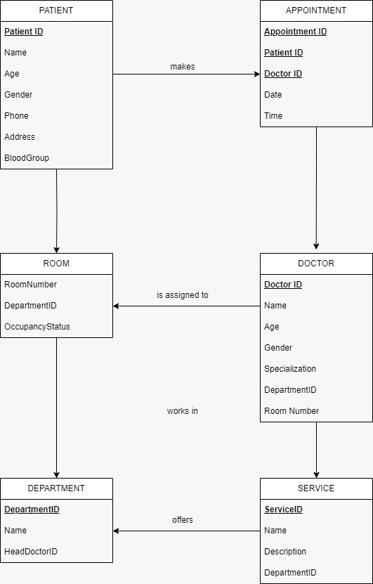
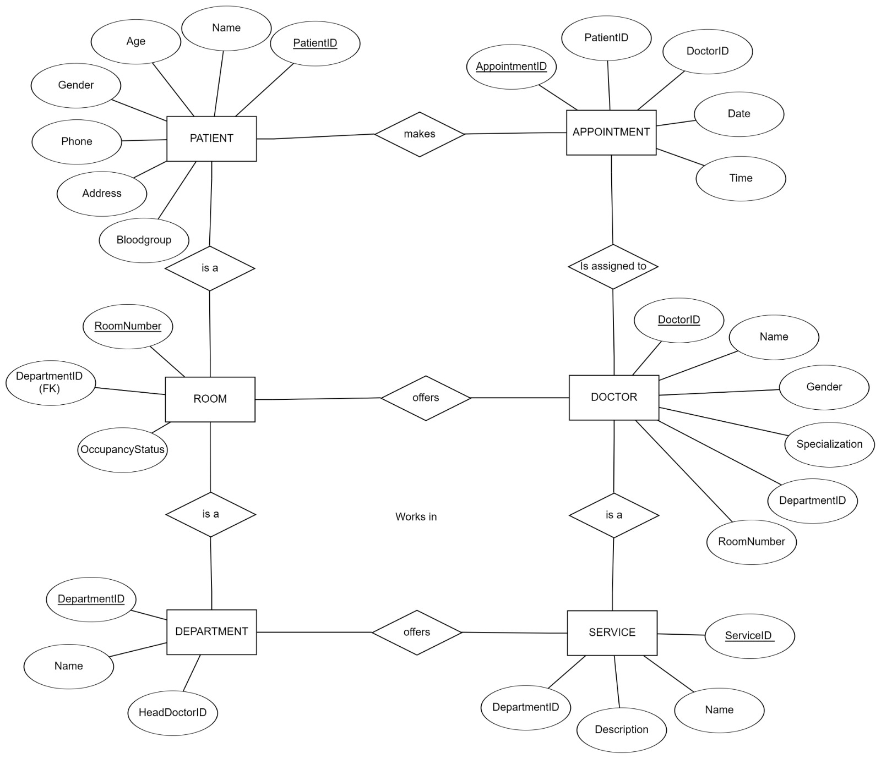
ENTITY RELATIONSHIP DIAGRAM

Slide 7
CODE
"doctor varchar(50),"
"date varchar(20),"
"time varchar(20),"
"appointment_no varchar(10))")
# Message for registration
def entry():
global e1,e2,e3,e4,e5,e6
p1=e1.get()
p2=e2.get()
p3=e3.get()
p4=e4.get()
p5=e5.get()
p6=e6.get()
query='insert into appointment values("{}", "{}", "{}", "{}", "{}", "{}")'.format(p1,p2,p3,p4,p5,p6)
con.commit()
cur.execute(query)
tkinter.messagebox.showinfo("DONE", "YOU HAVE BEEN REGISTERED")
# For registration
def register():
global e1,e2,e3,e4,e5,e6
root1=Tk()
label=Label(root1,text="REGISTER YOURSELF",font='arial 25 bold')
label.pack()
frame=Frame(root1,height=500,width=200)
import tkinter.messagebox
from tkinter import *
import mysql.connector as sqlcon
import random as rd
con=sqlcon.connect(host="127.0.0.1",user="root",password="root")#connection to mysql
cur = con.cursor(buffered=True)
if (cur):
# Carry out normal procedure
print ("Connection successful")
else:
print ("Connection unsuccessful")
cur.execute("create database if not exists Hospital")
cur.execute("use Hospital")
cur.execute("create table if not exists appointment"
"("
"idno varchar(12) primary key,"
"name char(50),"
"age char(3),"
"gender char(1),"
"phone varchar(10),"
"bg varchar(3))")
cur.execute("create table if not exists appointment_details"
"("
"idno varchar(12) primary key,"

Slide 8
b1=Button(root1,text="SUBMIT",command=entry)
b1.place(x=150,y=370)
root.resizable(False,False)
root1.mainloop()
# Message for appointment
def apo_details():
global x1,x2,h,p1,p2,p3,o,x4,x3
p1=x2.get()
p2=x3.get()
p3=x4.get()
if int(p1)==1:
i=("Dr. sharma \nRoom no:- 10")
j=("Dr. Verma \nRoom no:- 11")
q=(i,j)
h=rd.choice(q)
u=(23,34,12,67,53,72)
o=rd.choice(u)
det = (
"Your appointment is fixed with: {}\n"
"Date: {}\n"
"Time: {}\n"
"Appointment no: {}"
frame.pack()
l1=Label(root1,text="AADHAR CARD NO.")
l1.place(x=10,y=130)
e1=tkinter.Entry(root1)
e1.place(x=100,y=130)
l2=Label(root1,text="NAME")
l2.place(x=10,y=170)
e2=tkinter.Entry(root1)
e2.place(x=100,y=170)
l3=Label(root1,text="AGE")
l3.place(x=10,y=210)
e3=tkinter.Entry(root1)
e3.place(x=100,y=210)
l4=Label(root1,text="GENDER M\F")
l4.place(x=10,y=250)
e4=tkinter.Entry(root1)
e4.place(x=100,y=250)
l5=Label(root1,text="PHONE")
l5.place(x=10,y=290)
e5=tkinter.Entry(root1)
e5.place(x=100,y=290)
l6=Label(root1,text="BLOOD GROUP")
l6.place(x=10,y=330)
e6=tkinter.Entry(root1)
e6.place(x=100,y=330)

Slide 9
q=(i,j)
h=rd.choice(q)
u=(23,34,12,67,53,72)
o=rd.choice(u)
det = (
"Your appointment is fixed with: {}\n"
"Date: {}\n"
"Time: {}\n"
"Appointment no: {}"
).format(h, p2, p3, o)
query='insert into appointment_details values("{}", "{}", "{}", "{}", "{}")'.format(p1,h,p2,p3,o)
cur.execute(query)
tkinter.messagebox.showinfo("APPOINTMENT DETAILS",det)
elif int(p1)==4:
i=("Dr. Virat, \nRoom no. 18")
j=("Dr. Leo \nRoom no. 19")
q=(i,j)
h=rd.choice(q)
u=(23,34,12,67,53,72)
o=rd.choice(u)
det = (
"Your appointment is fixed with: {}\n"
"Date: {}\n"
"Time: {}\n"
"Appointment no: {}"
).format(h, p2, p3, o)
query='insert into appointment_details values("{}", "{}", "{}", "{}", "{}")'.format(p1,h,p2,p3,o)
cur.execute(query)
tkinter.messagebox.showinfo("APPOINTMENT DETAILS",det)
elif int(p1)==2:
i=("Dr. Sidharth \nRoom no. 16")
j=("Dr. Tendulkar \nRoom no. 17")
q=(i,j)
h=rd.choice(q)
u=(23,34,12,67,53,72)
o=rd.choice(u)
det = (
"Your appointment is fixed with: {}\n"
"Date: {}\n"
"Time: {}\n"
"Appointment no: {}"
).format(h, p2, p3, o)
query='insert into appointment_details values("{}", "{}", "{}", "{}", "{}")'.format(p1,h,p2,p3,o)
cur.execute(query)
tkinter.messagebox.showinfo("APPOINTMENT DETAILS",det)
elif int(p1)==3:
i=("Dr. Kumar \nRoom no. 12")
j=("Dr. Khan \nRoom no. 13")

Slide 10
q=(i,j,k,l)
h=rd.choice(q)
u=(23,34,12,67,53,72)
o=rd.choice(u)
det = (
"Your appointment is fixed with: {}\n"
"Date: {}\n"
"Time: {}\n"
"Appointment no: {}"
).format(h, p2, p3, o)
query='insert into appointment_details values("{}", "{}", "{}", "{}", "{}")'.format(p1,h,p2,p3,o)
cur.execute(query)
tkinter.messagebox.showinfo("APPOINTMENT DETAILS",det)
else:
tkinter.messagebox.showwarning('WRONG INPUT','PLEASE ENTER VALID VALUE')
# For appointment
def get_apoint():
global x1,x2,x3,x4
p1=x1.get()
cur.execute('select * from appointment where idno=(%s)',(p1,))
dat=cur.fetchall()
a=[]
for i in dat:
a.append(i)
).format(h, p2, p3, o)
query='insert into appointment_details values("{}", "{}", "{}", "{}", "{}")'.format(p1,h,p2,p3,o)
cur.execute(query)
tkinter.messagebox.showinfo("APPOINTMENT DETAILS",det)
elif int(p1)==5:
i=("Dr. Kohli \nRoom no. 14")
j=("Dr. singh \nRoom no. 15")
q=(i,j)
h=rd.choice(q)
u=(23,34,12,67,53,72)
o=rd.choice(u)
det = (
"Your appointment is fixed with: {}\n"
"Date: {}\n"
"Time: {}\n"
"Appointment no: {}"
).format(h, p2, p3, o)
query='insert into appointment_details values("{}", "{}", "{}", "{}", "{}")'.format(p1,h,p2,p3,o)
cur.execute(query)
tkinter.messagebox.showinfo("APPOINTMENT DETAILS",det)
elif int(p1)==6:
i=("Dr. Irfan \nRoom no. 001")
j=("Dr. John \nRoom no. 002")
k=("Dr. Sanjay \nRoom no. 003")
l=("Dr. Shahid \nRoom no. 004")

Slide 11
phone=Label(root3,text='PHONE:-')
phone.place(x=50,y=120)
phone1=Label(root3,text=i[4])
phone1.place(x=100,y=120)
bg=Label(root3,text='BLOOD GROUP:-')
bg.place(x=50,y=140)
bg1=Label(root3,text=i[5])
bg1.place(x=150,y=140)
L=Label(root3,text='DEPARTMENTS')
L.place(x=50,y=220)
L1=Label(root3,text="1.Orthopaedic surgeon ")
L1.place(x=50,y=250)
L2=Label(root3,text='2.Physician')
L2.place(x=50,y=270)
L3=Label(root3,text='3.Nephrologist')
L3.place(x=50,y=290)
L4=Label(root3,text='4.Neurologist')
L4.place(x=50,y=310)
L5=Label(root3,text='5.Gynaecologist')
L5.place(x=50,y=330)
L6=Label(root3,text='6.X-ray')
L6.place(x=50,y=350)
L7=Label(root3,text='Enter your choice')
L7.place(x=100,y=370)
x2=tkinter.Entry(root3)
if len(a)==0:
tkinter.messagebox.showwarning("ERROR", "NO DATA FOUND!!")
else:
root3=Tk()
label=Label(root3,text="APPOINTMENT",font='arial 25 bold')
label.pack()
frame=Frame(root3,height=500,width=300)
frame.pack()
if i[3]=='M' or i[3]=='m':
x="Mr."
name2=Label(root3,text=i[1])
name2.place(x=140,y=80)
else:
x="Mrs\Ms."
name2=Label(root3,text=i[1])
name2.place(x=170,y=80)
for i in dat:
name=Label(root3,text='WELCOME')
name.place(x=50,y=80)
name1=Label(root3,text=x)
name1.place(x=120,y=80)
age=Label(root3,text='AGE:-')
age.place(x=50,y=100)
age1=Label(root3,text=i[2])
age1.place(x=100,y=100)

Slide 12
b1=Button(root2,text='Submit',command=get_apoint)
b1.place(x=100,y=160)
root2.resizable(False,False)
root2.mainloop()
# List of doctors
def lst_doc():
root4=Tk()
l=["Dr. sharma","Dr. Verma","Dr. Kumar","Dr. Khan","Dr. Kohli","Dr. singh","Dr. Sidharth","Dr. tendulkar","Dr. Virat","Dr. Leo",'Dr. Irfan','Dr. John',
'Dr. Sanjay','Dr. Shahid']
m=["Orthopaedic surgeon","Orthopaedic surgeon","Nephrologist","Nephrologist","Gynaecologist","Gynaecologist","Physician","Physician","Neurologist",
"Neurologist",'X-ray','X-ray','X-ray','X-ray']
n=[10,11,12,13,14,15,16,17,18,19,20,21,22,23]
frame=Frame(root4,height=500,width=500)
frame.pack()
l1=Label(root4,text='NAME OF DOCTORS')
l1.place(x=20,y=10)
count=20
for i in l:
count=count+20
l=Label(root4,text=i)
x2.place(x=200,y=370)
L7=Label(root3,text=('enter date')).place(x=100,y=400)
x3=tkinter.Entry(root3)
x3.place(x=200,y=400)
L8=Label(root3,text=('enter time in 24 hour format')).place(x=48,y=430)
x4=tkinter.Entry(root3)
x4.place(x=200,y=430)
B1=Button(root3,text='Submit',command=apo_details)
B1.place(x=120,y=480)
root3.resizable(False,False)
root3.mainloop()
# For AADHAAR
def apoint():
global x1
root2=Tk()
label=Label(root2,text="APPOINTMENT",font='arial 25 bold')
label.pack()
frame=Frame(root2,height=200,width=200)
frame.pack()
l1=Label(root2,text="AADHAAR NO.")
l1.place(x=10,y=130)
x1=tkinter.Entry(root2)
x1.place(x=100,y=130)

Slide 13
count1=20
for i in f:
count1=count1+20
l3=Label(root5,text=i)
l3.place(x=20,y=count1)
l2=Label(root5,text='ROOM NO.')
l2.place(x=140,y=10)
g=[1,2,3,4,5,6,7,8,9]
count2=20
for i in g:
count2=count2+20
l4=Label(root5,text=i)
l4.place(x=140,y=count2)
l5=Label(root5,text='To avail any of these please contact on our no.:- 94887-43479')
l5.place(x=20,y=240)
root5.resizable(False,False)
root5.mainloop()
def modify():
global x3,x4,choice,new,x5,root6
p1=x3.get()
cur.execute('select * from appointment where idno=(%s)',(p1,))
dat=cur.fetchall()
a=[]
l.place(x=20,y=count)
l2=Label(root4,text='DEPARTMENT')
l2.place(x=140,y=10)
count1=20
for i in m:
count1=count1+20
l3=Label(root4,text=i)
l3.place(x=140,y=count1)
l4=Label(root4,text='ROOM NO')
l4.place(x=260,y=10)
count2=20
for i in n:
count2=count2+20
l5=Label(root4,text=i)
l5.place(x=260,y=count2)
root.resizable(False,False)
root4.mainloop()
def ser_avail():
root5=Tk()
frame=Frame(root5,height=500,width=500)
frame.pack()
l1=Label(root5,text='SERVICES AVAILABLE')
l1.place(x=20,y=10)
f=["ULTRASOUND","X-RAY","CT Scan","MRI","BLOOD COLLECTION","DIALYSIS","ECG","CHEMIST","LAB"]

Slide 14
choice=x4.get()
x4.place(x=100,y=330)
for i in dat:
name=Label(root6,text='NAME:-')
name.place(x=50,y=80)
name1=Label(root6,text=i[1])
name1.place(x=150,y=80)
age=Label(root6,text='AGE:-')
age.place(x=50,y=100)
age1=Label(root6,text=i[2])
age1.place(x=150,y=100)
gen=Label(root6,text='GENDER:-')
gen.place(x=50,y=120)
gen1=Label(root6,text=i[3])
gen1.place(x=150,y=120)
pho=Label(root6,text='PHONE:-')
pho.place(x=50,y=140)
pho1=Label(root6,text=i[4])
pho1.place(x=150,y=140)
bg=Label(root6,text='BLOOD GROUP:-')
bg.place(x=50,y=160)
bg1=Label(root6,text=i[5])
bg1.place(x=150,y=160)
b=Button(root6,text='Submit',command=do_modify)
b.place(x=50,y=400)
for i in dat:
a.append(i)
if len(a)==0:
tkinter.messagebox.showwarning("ERROR", "NO DATA FOUND!!")
else:
root6=Tk()
frame=Frame(root6,height=500,width=500)
frame.pack()
l1=Label(root6,text='DATA MODIFICATION',font="arial 15 bold")
l1.place(x=75,y=10)
l2=Label(root6,text='WHAT YOU WANT TO CHANGE')
l2.place(x=50,y=200)
l3=Label(root6,text='1.NAME')
l3.place(x=50,y=220)
l4=Label(root6,text='2.AGE')
l4.place(x=50,y=240)
l5=Label(root6,text='3.GENDER')
l5.place(x=50,y=260)
l6=Label(root6,text='4.PHONE')
l6.place(x=50,y=280)
l7=Label(root6,text='5.BLOOD GROUP')
l7.place(x=50,y=300)
x2=Label(root6,text='Enter')
x2.place(x=50,y=330)
x4=tkinter.Entry(root6)

Slide 15
L1=Label(root6,text='OLD DETAILS')
L1.place(x=50,y=50)
L2=Label(root6,text='ENTER NEW DETAIL')
L2.place(x=50,y=360)
x5=tkinter.Entry(root6)
new=x5.get()
x5.place(x=160,y=360)
root6.resizable(False,False)
root6.mainloop()
def do_modify():
global ad,x3,x4,x5
ad=x3.get()
choice=x4.get()
new=x5.get()
if choice=='1':
cur.execute('update appointment set name="{}" where idno="{}"'.format(new,ad))
elif choice=='2':
cur.execute('update appointment set age="{}" where idno="{}"'.format(new,ad))
elif choice=='3':
cur.execute('update appointment set gender="{}" where idno="{}"'.format(new,ad))
elif choice=='4':
cur.execute('update appointment set phone="{}" where idno="{}"'.format(new,ad))
elif choice=='5':
cur.execute('update appointment set bg="{}" where idno="{}"'.format(new,ad))
else:
pass
root6.destroy()
tkinter.messagebox.showinfo("DONE", "YOUR DATA HAS BEEN MODIFIED")
choice=None
new=None
ad=None
def mod_sub():
global x3,ad
root7=Tk()
label=Label(root7,text="MODIFICATION",font='arial 25 bold')
label.pack()
frame=Frame(root7,height=200,width=200)
frame.pack()
l1=Label(root7,text="AADHAAR NO.")
l1.place(x=10,y=130)
x3=tkinter.Entry(root7)
x3.place(x=100,y=130)
ad=x3.get()
b1=Button(root7,text='Submit',command=modify)
b1.place(x=100,y=160)
root7.resizable(False,False)
root7.mainloop()
def search_data():
global x3,ad
root7=Tk()
label=Label(root7,text="SEARCH DATA",font='arial 25 bold')
label.pack()

Slide 16
frame=Frame(root7,height=200,width=200)
frame.pack()
l1=Label(root7,text="AADHAAR NO.")
l1.place(x=10,y=130)
x3=tkinter.Entry(root7)
x3.place(x=100,y=130)
ad=x3.get()
b1=Button(root7,text='Submit',command=view_data)
b1.place(x=100,y=160)
root7.resizable(False,False)
root7.mainloop()
def view_data():
global p1
p1=x3.get()
cur.execute('select * from appointment where idno=(%s)',(p1,))
dat=cur.fetchall()
print(dat)
a=[]
for i in dat:
a.append(i)
if len(a)==0:
tkinter.messagebox.showwarning("ERROR", "NO DATA FOUND!!")
else:
det=a
tkinter.messagebox.showinfo("APPOINTMENT DETAILS",det)
root=Tk()
label=Label(root,text="HOSPITAL MANAGEMENT SYSTEM",font="arial 40 bold",bg='light blue')
b1=Button(text="Registration",font="arial 20 bold",bg='yellow',command=register)
b2=Button(text="Appointment",font="arial 20 bold",bg='yellow',command=apoint)
b3=Button(text="List of Doctors",font="arial 20 bold",bg='yellow',command=lst_doc)
b4=Button(text="Services available",font='arial 20 bold',bg='yellow',command=ser_avail)
b7=Button(text="View data",font='arial 20 bold',bg='yellow',command=search_data)
b5=Button(text="Modify existing data",font='arial 20 bold',bg='yellow',command=mod_sub)
b6=Button(text="Exit",font='arial 20 bold',command=root.destroy,bg='violet')
label.pack()
b1.pack(side=LEFT,padx=10)
b3.pack(side=LEFT,padx=10)
b4.pack(side=LEFT,padx=10)
b2.place(x=25,y=500)
b7.pack(side=LEFT,padx=10)
b5.place(x=350,y=500)
b6.place(x=800,y=500)
frame=Frame(root,height=600,width=50)
frame.pack()
root.resizable(False,False)
root.mainloop()

Slide 17
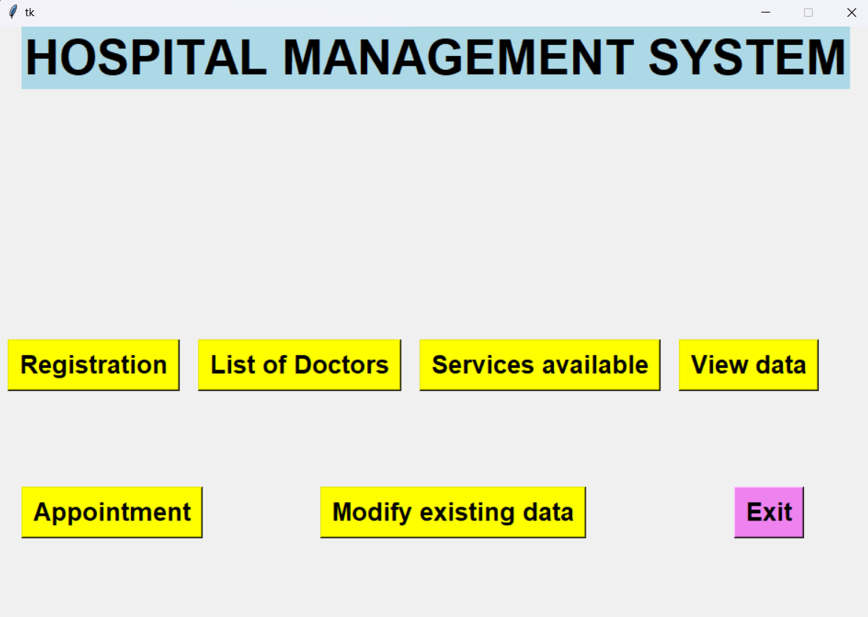
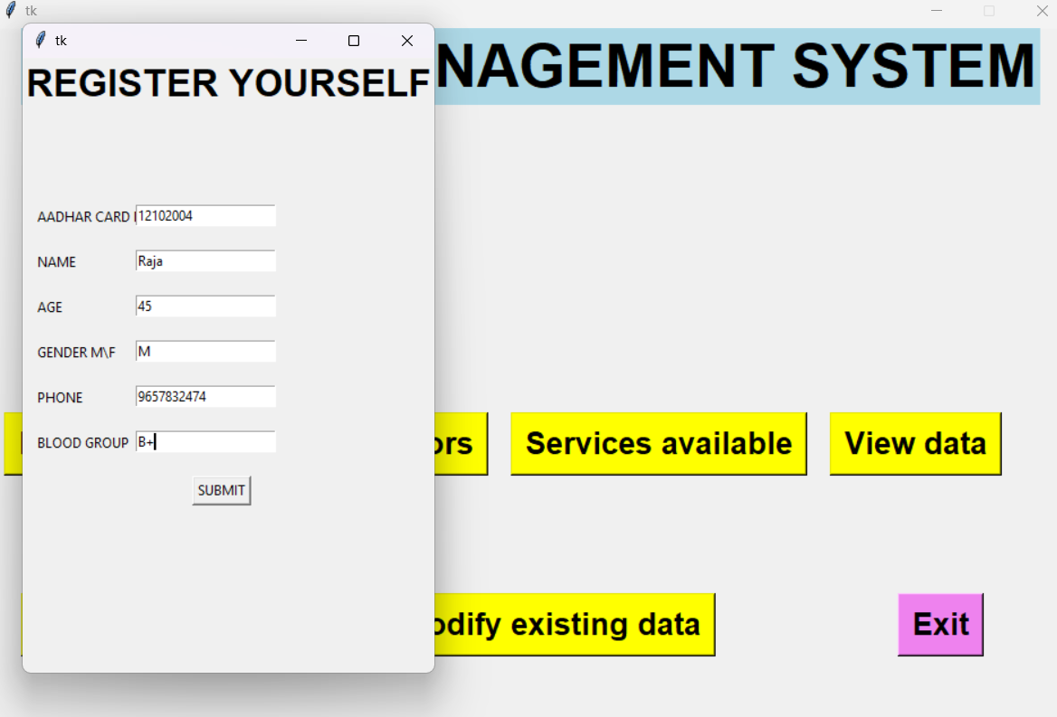
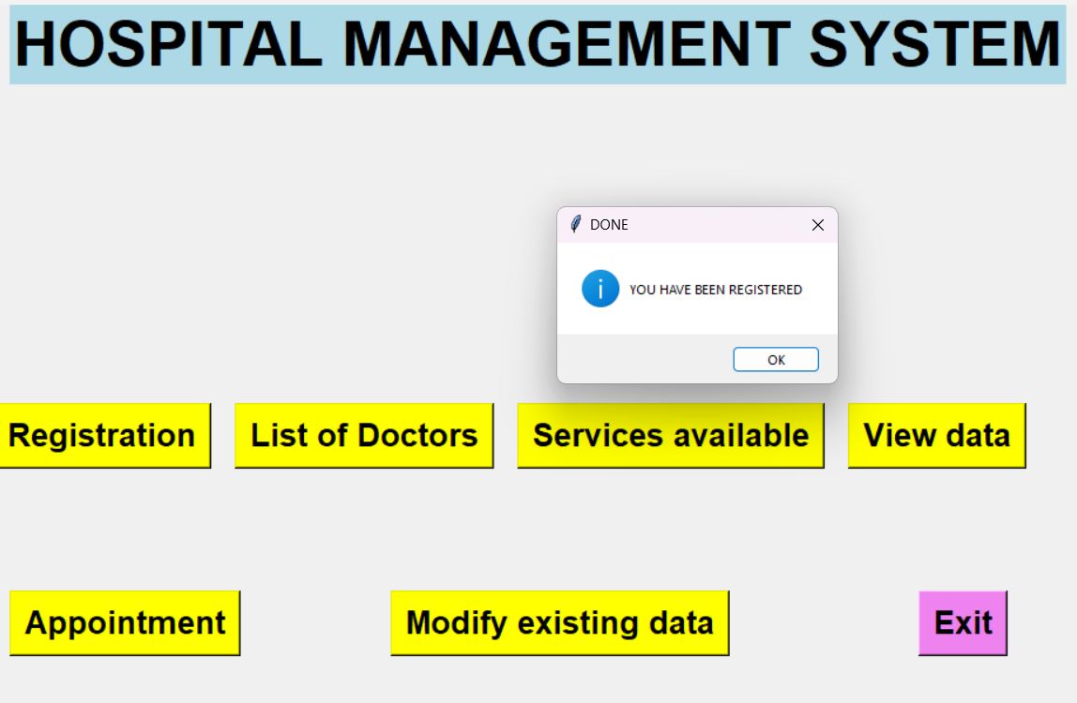
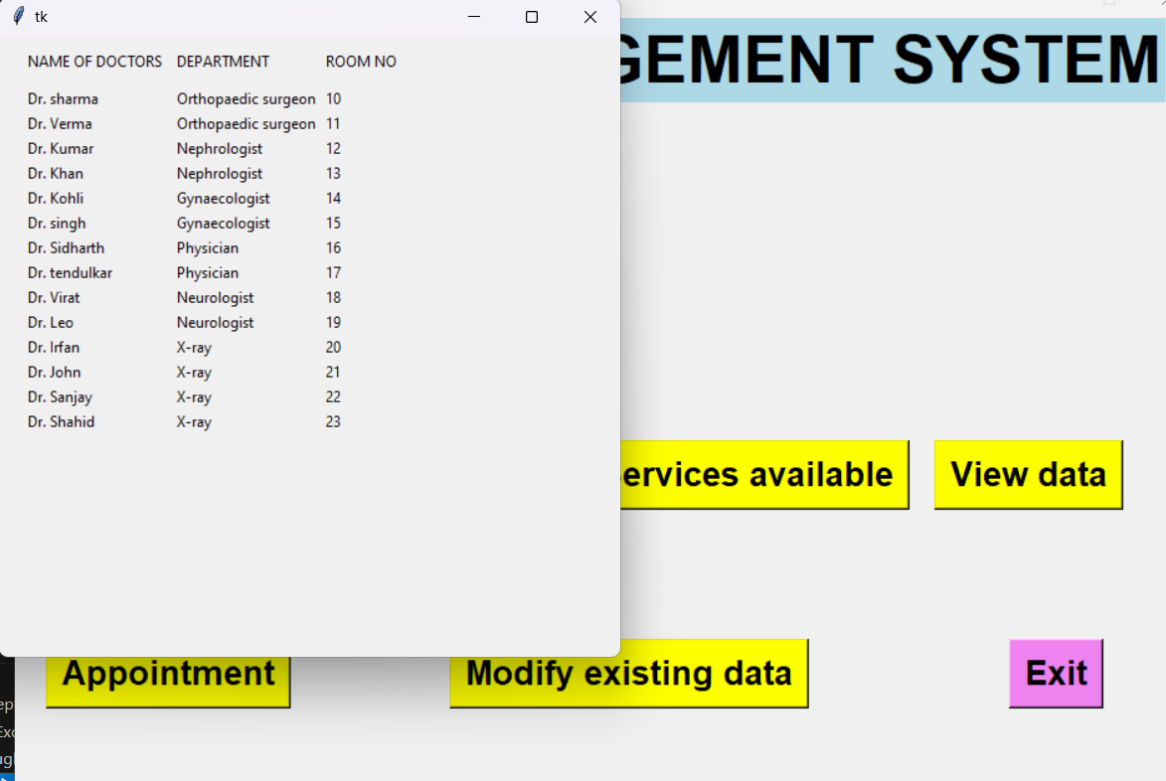
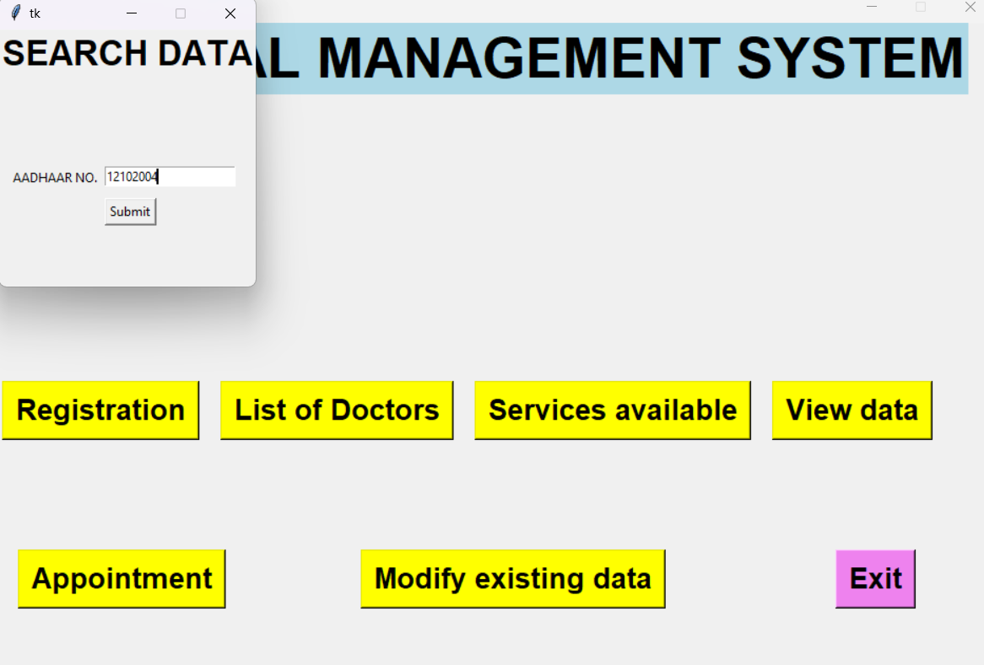
OUTPUT
MAIN PAGE
REGISTRATION PAGE
REGISTRATION SUCCESSFUL
LIST OF DOCTORS
VIEW DATA

Slide 18
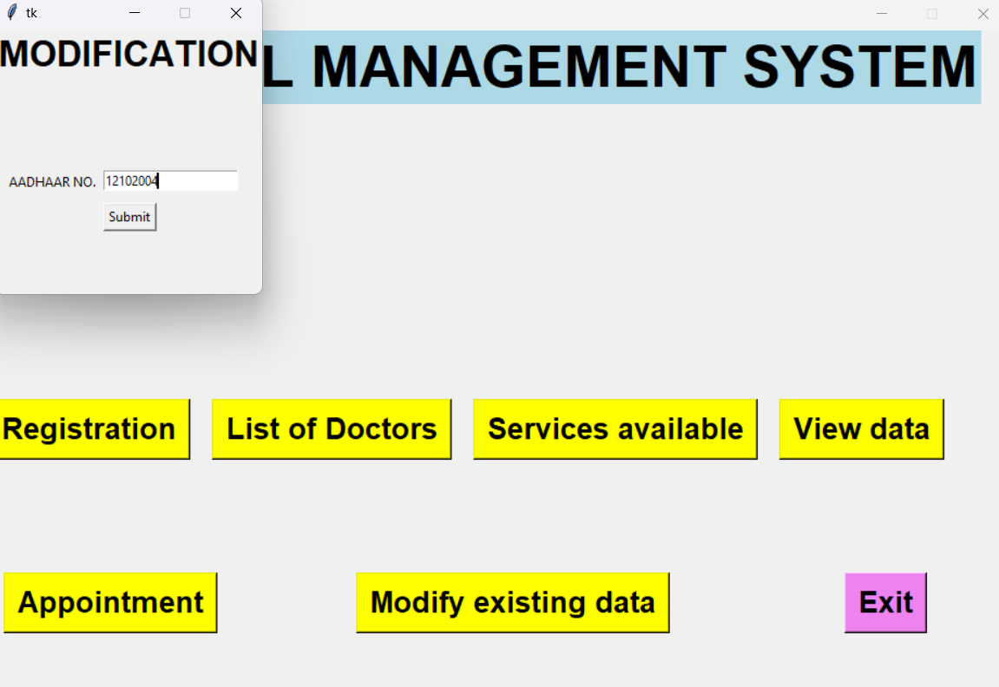
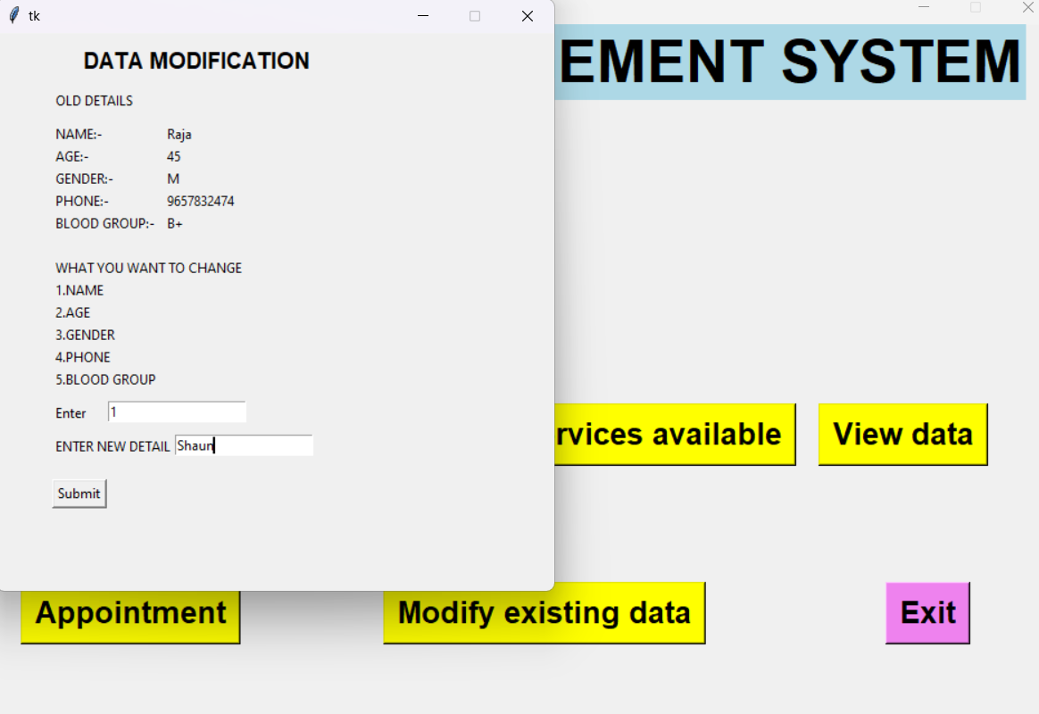
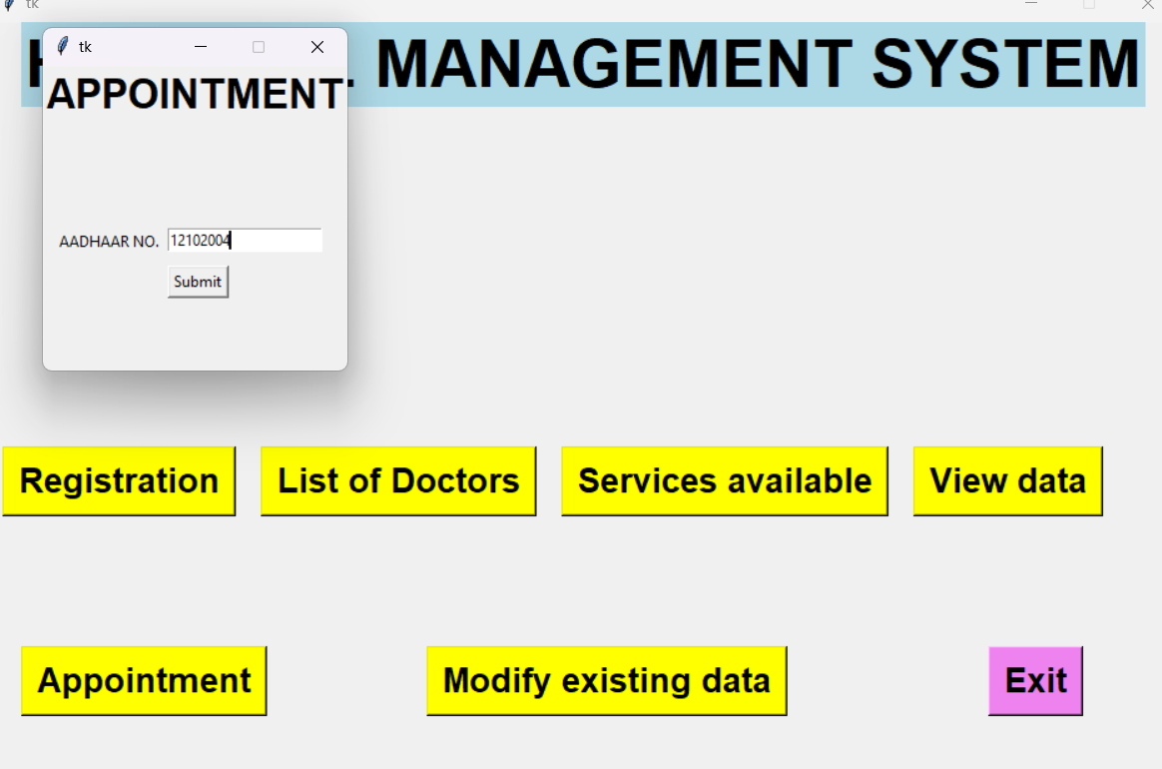
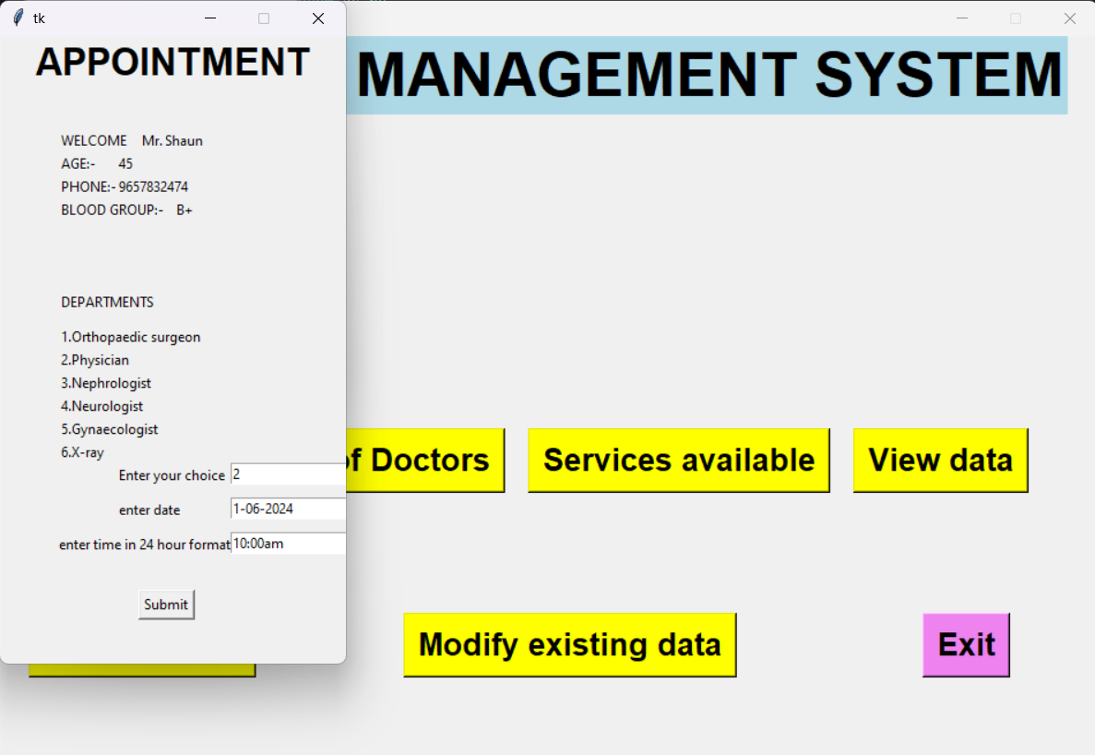
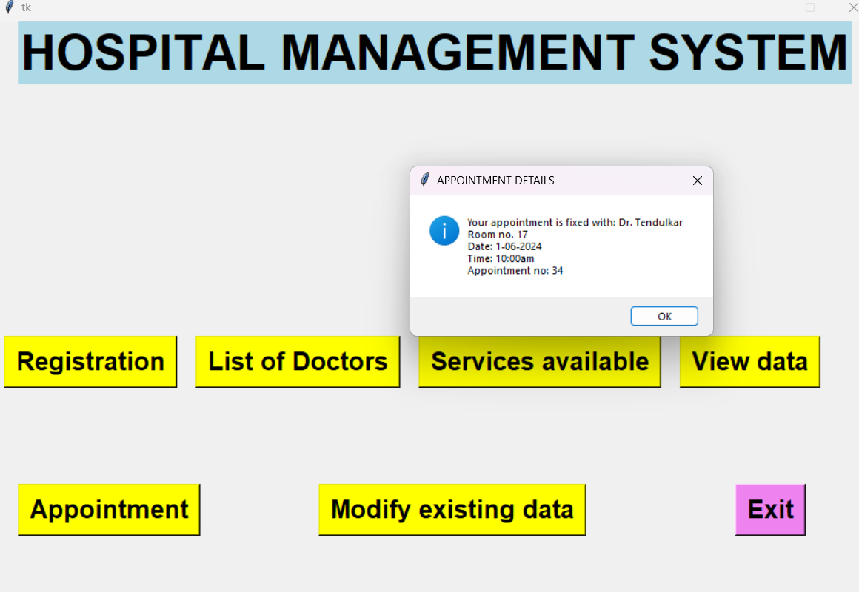
OUTPUT
MODIFY EXISTING DATA
MODIFICATION PROCESS
BOOK AN APPOINTMENT USING AADHAR
BOOKING AN APPOINTMENT
BOOKING SUCCESSFUL

Slide 19
THANKYOU

